Slide 1
COMP6230 Implementing Cyber Security
Security Planning:
Planning for when it all goes wrong

Slide 2
Don't worry,
it will never happen to us...
Notes:
The Mountbatten building disappeared, it has happened twice in ECS history

Slide 3
Today's Programme
Administering security
Planning
Policy
Back-ups

Slide 4
Security Administration
“What good is a firewall in a fire...?”
What happens if (actually happened):
The power goes off -UPS
An employee emails out sensitive data, or leaves a laptop on the train, or a cd is lost in the post
Someone walks off with the certificate server?
Notes:
ECS fire One of the issues was that the server were in the building that burnt down.
Uninterruptable power supplies, will they give you enough time to shut down properly

Slide 5
Security Administration
Consists of:
Planning (this time)‏
Policy (this time)‏
Risk Analysis (next time)‏
Physical Control (next time)‏

Slide 6
Governance
An overview

Slide 7
Corporate Governance
“is the system by which companies are directed and controlled” (Cadbury, 1992).
Responsibility of the board of directors to :
provide strategic direction,
ensuring objectives have been achieved,
ascertaining risks are managed appropriately
verifying that the organisational resources are used responsibly
Not Management but direct and control

Slide 8
Corporate Governance
Create an organisational Culture do the organisations achieves its goal
directed by producing the policies, standards and procedures from the strategic to the tactical to the operational level,
controlled by measuring, monitoring and reporting compliance, from the operational to the tactical to the strategic level,
which are all subject to laws and regulations

Slide 9
Corporate Governance
Hit the headline in the 1990s because of several scandals Maxwell (UK) Enron (USA)
In response new laws and regulations, principles and frameworks have been developed.
effectiveness of good CG is based on transparency and information disclosure
The Sarbanes-Oxley Act of 2002 was enacted
Organisation for Economic Co-operation and Development:- Principles of Corporate Governance, first published as the OECD Principles in 1999, revised in 2004 and revised again and endorsed by the G20 in 2015
The UK passed the Bribery Act in 2010.

Slide 10
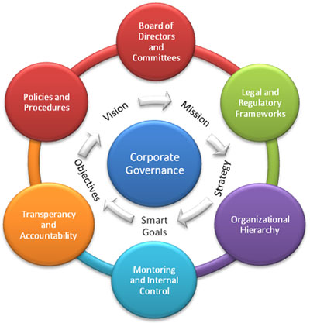
Corporate Governance
Source: http://spendmatters.com/tfmatters/corporate-governance-impacts-trade-credit/

Slide 11
IT Governance
As Information Technology is an asset that it critical to the success of the organisation it is subject to governance ruling.
IT assists the enterprise to attain a competitive advantage, since it increases the enterprise efficiency and productivity and reduces cost
IT governance the creation of an accountability framework that drives the desired behaviour in the use of IT.
The IT should support the corporate strategy (not he other way around)

Slide 12
IT Governance
IT governance covers a large domain and organisation with different drivers and goals.
Therefore the different standards reflect these differences
ISO/IEC 38500 is most comprehensive standard of IT Governance and it contains set of guidance and principles to govern the use of IT
COBIT provides a set of recommended best practice for governance. It is also a good practice framework that defines a set of generic set of process for the management of IT

Slide 13
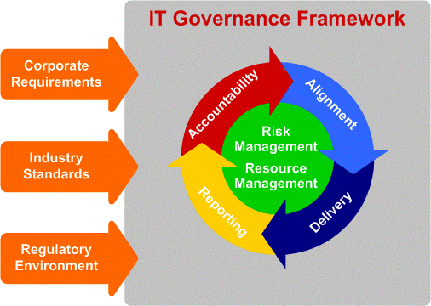
IT Governance
. Source: (Laudon & Laudon, 2005)

Slide 14
IT Security
The main objectives of Information Security is :
Protecting information confidentiality,
preserving information integrity,
promoting information availability,
exchanging information with trust,
authenticity and non-­‐ repudiation
Hence Information Security needs to be incorporate effectively into the everyday practice
performed that must be proactive,
cope effectively with the technological changes
the growing cybersecurity risks

Slide 15
Information Security Governance
In response to the growing security risk and the cost of disclosure Information Security is becoming an increasing important aspect of Corporate Governance.
It is not longer the technical management that are concerned about protection of information assets it has to involve the senior executive.
information assets (digital and physical) in transit, processing or storage to protect it from attack, damage or misuse

Slide 16
Information Security Governance
ISO/IEC 27014:2013 put the responsibility onto the governing body
ultimately accountable for an organisation’s decisions and performance,
their duty is to ensure that the organisation’s approach to Information Security is acceptable, effective, efficient and linked with business objectives and strategies.
Information Security is not just a technical issue but a governance challenge.

Slide 17
Information Security Governance
“the establishment and maintenance of a control environment to manage the risks relating to the confidentiality, integrity and availability of information and its supporting processes and systems” Moulton & Coles (2003)
The goals of Information Security Governance are to provide strategic direction and ensure objectives are accomplished, risks are managed properly, and resources are used responsibly (ITGI, 2006).

Slide 18
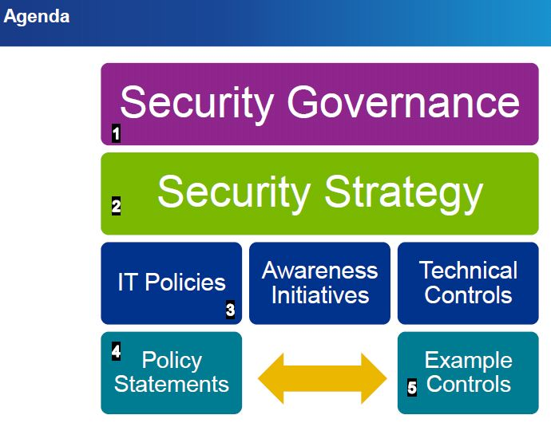
Information Security Governance
Source: http://www.mondaq.com/x/249538/Corporate+Governance/Information+Security+Governance+Security+Made+Simple+From+Threat+To+Policy+To+Control

Slide 19
IT Governance
ISO/IEC 27014, 2013 includes guidance on the concepts of ISG, to align IS activities with organisational strategy, based on six high level principles
Establish organisation-­‐wide Information Security
Adopt a risk-­‐based approach
Set the direction of investment decisions
Ensure conformance with internal and external requirements
Foster a security-­‐positive environment
Review performance in relation to business outcomes.

Slide 20
Planning
Thinking ahead

Slide 21
Planning
Consider:
A sensitive document looks important, but an unlabelled CD does not (difficult to stop)
Pen memory can be carried in and out of a restricted area without it being very obvious
Mobile phones have a memory card- Wireless connection
Notes:
Pen memory on key rings. Part of a pen or other device.

Slide 22
In groups
What is the purpose of a security plan?

Slide 23
Purpose of a Security Plan
Stop and Contain
Events are dealt with quickly and efficiently
Categorised and classified as security incidents or not.
Eradicate
Asses and respond in an appropriate manner
Minimise the effect of an incident on the organisation using appropriate controls

Slide 24
Purpose of a Security Plan
Report
Report and security vulnerabilities are assessed and dealt with appropriately
Follow-up: often not carried out
Lesson are learnt
Action plan in place
Action plan reviewed

Slide 25
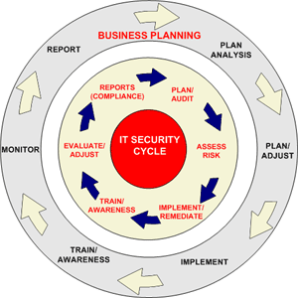
Security planning is part of Corporate planning
http://www.esecuritytogo.com/ccpage.aspx?pageid=3&name=services&name&lid=3&lgid=1

Slide 26
Planning
Require a:
Security Plan
Incident Response Plan
People know what to do
Business Continuity Plan

Slide 27
Planning
Security Plan requires:
Contents (next slide)‏
Author
e.g. Committee, 5-9 representative people
Support
Planners sensitive to user needs
User understanding of consequences of their actions
Management commitment
Note: importance of good communication!
Notes:
Author- Editor who takes control of the document, designed by committee danger of no clear planning.
iSoultion password change – users do not care, but education and make them responsible ownership and consequences
Management commitment not use hear say (lip service).

Slide 28
Security Plan Contents
Policy: goals, responsibility, commitment, authorisation
Current state: risk analysis, responsibilities, audit
Requirements (objectives, not implementation)‏
Correct, Consistent, Complete, Needs to be Realistic
Verifiable (pointless if you can't prove you've met requirements)
Traceable (need to be able to trace the effect of a requirement into implementation)‏
Notes:
Policy: No policy no goals,
goals, responsibility, commitment, authorisation (who, what, what sort of access)
‏
Current state: risk analysis, responsibilities, do an audit
Requirements (objectives, not implementation): need to be: *Correct *Consistent *Complete *Needed *Realistic *Verifiable (pointless if you can't prove you've you've met requirements) *Traceable (need to be able to trace the effect of a requirement into implementation)‏
Constraints: Budget, schedule, performance, external policies & regulations, customer acceptability, etc.
Recommendations: What controls will meet requirements
Accountability: who is accountable for what, including dealing with new threats
Timetable for implementation
Update policy: How will we respond when new vulnerability occurs?

Slide 29
Security Plan Contents
Constraints: Budget, schedule, performance, external policies & regulations, customer acceptability, etc.
Recommendations
Accountability: who is accountable for what, including dealing with new threats
Timetable for implementation
Update policy: How will we respond when new vulnerability occurs?
Notes:
Policy: No policy no goals,
goals, responsibility, commitment, authorisation (who, what, what sort of access)
‏
Current state: risk analysis, responsibilities, do an audit
Requirements (objectives, not implementation): need to be: *Correct *Consistent *Complete *Needed *Realistic *Verifiable (pointless if you can't prove you've you've met requirements) *Traceable (need to be able to trace the effect of a requirement into implementation)‏
Constraints: Budget, schedule, performance, external policies & regulations, customer acceptability, etc.
Recommendations: What controls will meet requirements
Accountability: who is accountable for what, including dealing with new threats
Timetable for implementation
Update policy: How will we respond when new vulnerability occurs?

Slide 30
Incident Response
Let people know

Slide 31
Background
An information security event that may compromise business operation and threaten information security.:
A possible breach of security policy or failure of control,
Previously unknown situation
Not necessarily successful so not all are classified as information security incidents

Slide 32
Background
A threat act is an unwanted ways to exploit the Vulnerabilities (weakness) of IS, services or networks
Causes
Exploits
Threat
Unwanted Action
Information Security Vulnerability
Occurrence of
Information Security event
Exposes
Classified as
Information security incident
Implications on Information Security
Information Asset

Slide 33
Incident Response Overview
At some point an organisations will experience an information security incident,
The reason for investing in and establishing incident management polices and procedure will :
help to improve resilience,
support business continuity,
improve customer and stakeholder confidence
reduce any financial impact

Slide 34
Incident Response Overview
A major disruption of business operations
Failure to realise that an incident has occurred or manage it effectively may result in a long term outage, serious financial loss and erosion of customer confidence
Continual business disruption
fails to address the root cause of incidents - weaknesses in the security architecture could lead to consistent and damaging business disruption
Failure to comply with legal and regulatory reporting requirements
A compromise of sensitive information covered by mandatory reporting controls that are not adhered to could lead to legal or regulatory penalties

Slide 35
Incident Response Plan Overview
Four phases:
Advance Planning
Triage Determine the extent of the incident Work to ensure the immediate impact is managed
Managing Incident Need a Response Team: Manager, Technical Leader, Advisers (lawyers, HR, PR...) Need to: preserve evidence, keep records, manage PR (don't help the attacker)‏
Review

Slide 36
Incident Response Plan:- Advances planning
Obtain senior management approval and backing
The board needs to understand the risks and provide funds and resources and lead the delivery
Establish an incident response capability
Identify funds and resources for an organisations incident capability, to address the full range of incidents
They could also outsources it –supported by policies, risks and legal and regulatory reporting.
Provide specialist training
Technical and forensic investigation.
Training and record keeping.

Slide 37
Incident Response Plan:- Advances planning
Define the required roles and responsibilities
Appoint and empower individuals - with a clearly defined terms of reference- to handle and manage incidences
Establish a data recovery capability
Requires a systematic approach to the backup
held in a physically secure location on-site and off-site
the ability to recover archived data for operational use should be regularly tested

Slide 38
Incident Response Plan
Decide what information will be shared and with whom
there are regulatory and legal requirements
Identify in the plan all internal and external reporting requirements
Test the incident management plans
The security incident plans-including Disaster Recovery and Business continuity- should be tested regularly
The outcomes help gauge the effectiveness and if changes need to be made
You do not know what you do not know.

Slide 39
Incident Response Plan Overview
For when an incident occurs. Needs to:
Define what an incident is
Identify person to handle it
Person responsible must check facts first
Describe plan of action
E-mail from head of IT account, unpleasant and illegal, traced via Interpol, all was clearly laid out in the plan

Slide 40
Incident Response Plan: Review
Collect and analyse post-incident evidence
The analysis of the activates that led up t the event is critical in identifying the root cause
This evidence will support and legal or insurance claims
Conduct a lessons learned review
Review the process and actions taken during the incidents
Does the Security Plan need updating? Did the Incident Response Plan work? Provide recommendations to remediate the compromise and increase security across the network
Notes:
What is an incident
Plan of action including who to contact.
E-mail through head of IT account, unpleasant and illegal, traced via Interpol, all was clearly laid out in the plan

Slide 41
Incident Response Plan: Review
Educate users and maintain their awareness
Uses should be aware of their responsibilities, and the procedures to be followed.
However, try an have a no-fault reporting systems, to encourage staff to report security issues
Report criminal incidents to Law Enforcement
Report crims to the relevant authority,
it helps build a clear picture of the local and national threat and helps law enforcement to respond appropriately.
Notes:
What is an incident
Plan of action including who to contact.
E-mail through head of IT account, unpleasant and illegal, traced via Interpol, all was clearly laid out in the plan

Slide 42
Incident Response
The HP Security Operations Centre team runs the core ServiceBizWorld processes for (IT) security event & incident management processes.
HP reported that heir customers could spend 15-150 days dealing with third parties after a major security incidence.
Due to a lack of specific SLA
Not formalising the transfer of information.
Notes:
What is an incident
Plan of action including who to contact.
E-mail through head of IT account, unpleasant and illegal, traced via Interpol, all was clearly laid out in the plan

Slide 43
HP Incident Response
The events/alerts collected from the Incident and Event management system could relate to:
Managed internal firewalls;
Managed network devices;
Domain authentication events
Malware security events;
Authentication events.
On average 35-40 events/alerts are processed on daily basis, i.e. about 12000-15000 per year.
Only a small fraction of these involve Major Security Incidents.
Notes:
What is an incident
Plan of action including who to contact.
E-mail through head of IT account, unpleasant and illegal, traced via Interpol, all was clearly laid out in the plan

Slide 44
HP Incident Response
“Events/Alerts Processing and Resolution Process”
providing the initial assessment of events/alerts;
gathering of relevant information from the involved Third parties to further analyse the events/alerts;
dealing with the final assessment of events/alerts and their classification as
false positives,
known problems,
events to be closed,
minor security incidents
major security incidents.
Notes:
What is an incident
Plan of action including who to contact.
E-mail through head of IT account, unpleasant and illegal, traced via Interpol, all was clearly laid out in the plan

Slide 45
HP Incident Response
On average, 800-900 major security incidents are raised on a yearly basis
The category of Major (IT) Security Incidents include:
discovery of exposure of internal devices and systems to the Internet;
unauthorised privilege escalation;
malware security incidents;
security log cleaning;
misuse of authentication tokens;
incidents raised from internal firewalls.
Notes:
What is an incident
Plan of action including who to contact.
E-mail through head of IT account, unpleasant and illegal, traced via Interpol, all was clearly laid out in the plan

Slide 46
HP Incident Response
HP reported typical times for the Event/Alerts processing and resolution
Initial analysis: -between 1hour and 2 days.
Information Gathering (including Third Parties): -between 1hour and 10 days.
Final assessment 4 hours and 5 days
Event closure 1hour and 1 day.
For management report activates added to this time.
Hence it can be a while before theCEO knows of a problem
Notes:
What is an incident
Plan of action including who to contact.
E-mail through head of IT account, unpleasant and illegal, traced via Interpol, all was clearly laid out in the plan

Slide 47
Policy
What everyone else should do

Slide 48
What would you expect a security policy to do? What is the difference between a Security policy for a n Organisation and a Network?

Slide 49
Policy
Basically deals with authorisation
Should be sufficiently high-level that it doesn't change frequently
Demonstrates management commitment
Detail is diverted to “procedures” or “guidelines”

Slide 50
Policy
Has:
Purpose
e.g. Identify sensitive assets, clarify responsibilities, promote awareness, etc.
Audience
e.g. Users, owners, beneficiaries. May need to consider balance between competing interests
Contents
Including purpose (!) resources, nature of protection

Slide 51
Policy
A good policy has:
Coverage i.e. Covers all(?) potential situations
Durability should continue to apply as organisation changes
Realism “You could spend a bit less on security if you spend it smarter” (Anderson)‏
Usefulness policy should be succinct, clear & direct

Slide 52
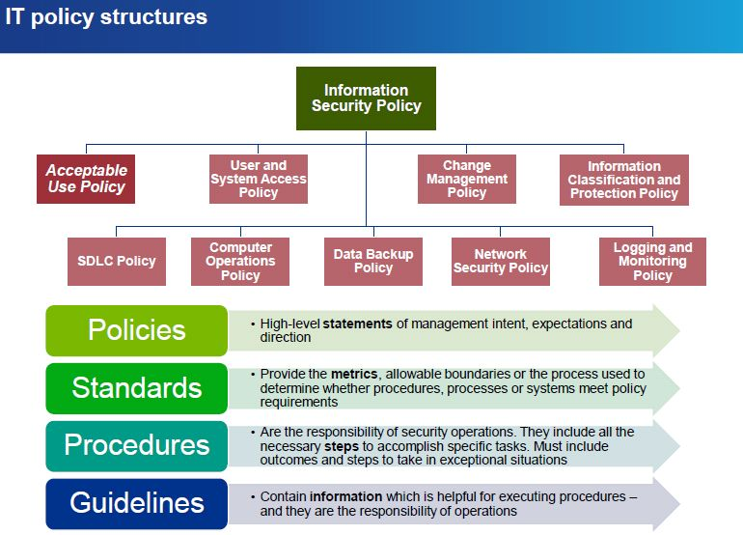
Policy
Source: http://www.mondaq.com/x/249538/Corporate+Governance/Information+Security+Governance+Security+Made+Simple+From+Threat+To+Policy+To+Control

Slide 53
Network Security Policy
Do not confuse a Security Policy for an Organisation with a Network Security Policy
outlines rules for computer network access,
how policies are enforced
lays out basic architecture of the company security/ network security environment.
It's a very complex document, meant to govern data access, web-browsing habits, use of passwords and encryption, email attachments and more.
It specifies these rules for individuals or groups of individuals throughout the company.

Slide 54
Continuity Planning
When it goes wrong

Slide 55
Business Continuity Plan
Deals with:
Catastrophic, and
Long duration
incidents.
Typical threats:
Fire (!)‏
Critical software failure
Electrical supply failure
Flood
Notes:
Type of things and duration: critical-short, critical-long
Issue s what are you going to do in order to keep the business going.
We are a business

Slide 56
Business Continuity Plan
Must:
Assess business impact What are the essential assets? What might disrupt use of those assets?
Develop a strategy e.g. Data back-up (how & where... !) Alternate (manual) process Operate with reduced capacity → who takes the hit? Accepting help → hidden agendas?
Consider how to implement strategy Who will be in charge, what will need to be done, who will do the work?
Notes:
Data back up how and where
Alternative process when the systems go down your customers can be paid or getting goods out (hotel, supermarket)
Mountbatten help
Just think of the disaster you’re hear on TV, and “no one knew what to do”.

Slide 57
Business Continuity Plan
Note:
Importance of prior training
Don't want to add confused people to a confused situation
Plan justifies expenditure
On “redundant” equipment – rather like life insurance, really...
Notes:
Why plan for what may never happen, and you hope it is a waste of money. But if it does occur it must work or the consequences are great.
The plan allows you to justify the costs.
If it is important to me then I need some assurance when it goes wrong.

Slide 58
Planning
OK, so we spend a lot of time and effort on planning for all sorts of things that may never happen – then the one thing we never thought of happens...
On the other hand, thinking ahead with a clear mind is easier than responding on the fly in confusion
Notes:
Planning gives the possibility of handling a situations well.

Slide 59
Recovering
Back-up

Slide 60
Back-ups
A First In, First Out (FIFO)
The n tapes are recycles so that the oldest on is used fro todays backup.
Simplest, for personal backups, naive and can lead to data loss.
keeps the longest possible tail of daily backups.
10 tapes (floppy discs) , will give you 10 days back-up
Good if you only need to go back a short while as the relevance of the data is shorter than the rotation period.
Notes:
a file in which an unsuspected error is introduced. Several generations of backups and revisions have since occurred. The error is then detected. At this time, it would be pointless to have all of the most recent generations because all of them have the error. It would instead be beneficial to have at least one of the older generations, as it would not have the error.

Slide 61
Grandfather-father-son
Most common-designed originally for tapes
Son is incremental daily backups, tapes are rotated daily, one graduates to a father.
The weekly back up –father- rotated weekly, one graduates to a Grandfather (monthly)
quarterly, annual backs can be used too
Notes:
. The basic method is to define three sets of backups, such as daily, weekly and monthly. The daily, or son, backups are rotated on a daily basis with one graduating to father status each week. The weekly or father backups are rotated on a weekly basis with one graduating to grandfather status each month. In addition, quarterly, biannual, and/or annual backups can also be separately retained. Often one or more of the graduated backups is removed from the site for safekeeping and disaster recovery purposes.

Slide 62
Tower of Hanoi
recursive method
effective number of backups
the ability to go back over time
complicated
Each tape is given a number in the puzzel
A set of n tapes) will allow backups for 2 ^{n-1} days before the last set is recycled
3 tapes 7days, 5 tapes 31 days

Slide 63
Summary
Information security should not be considered as a technical issue but it should be regarded as governance challenge.
Effective IS requires active involvement of executive management in order to ensure:
the organisation is using all its resources securely and efficiently,
with accountability and compliance with laws and regulations
in order to sustain a successful and profitable business operation
support organisational strategies and objectives.

Slide 64
Questions
Why do we need a security plan
What does a business continuity plan aim to do.
Do I really need to spend time writing an incident plan for all the possible incidences, (explain the yes/no answer)
What is the purpose of a security policy
How can we undertake effect back-ups

Slide 65
COMP3201 Exam questions
You have recently been appointed as systems manager. Your organisation’s Chief Information Officer (CIO) wants you to review the security plan.
Explain why a security plan is necessary. 7 Marks
When writing a Security plan what do you need to consider 8Marks
What is the difference between a security plan and a security policy 7 Marks
When writing a Security plan what do you need to consider 8 Marks
Back-ups are part of a good recovery plan, give two examples of back-up procedures. 8 Marks

